Slide 1
Email Marketing
How To Build A Successful Email Program

Slide 2
Email Marketing 101 Agenda
Why Email Marketing?
Types of Emails
Email Best Practices
Email Metrics
List Health
Recommended Email Platforms
2

Slide 3
Why Email Marketing?

Slide 4

Why email marketing?
Affordable
Other than platform fees, it is free to communicate with your subscribers
It works!
Engage your subscribers, foster loyalty and (most importantly) drive revenue
It’s becoming harder & harder to reach consumers organically on social media
Email can be easily measured than other organic efforts, allowing you to track improvements & quantify return
Consumers prefer email
Subscribers chose to sign up for your emails – they want to hear from you!
Email can be less disruptive than ads or other notifications
It’s a great testing ground
Not sure how you want to position your products or the best tagline for your brand? Email is the easiest & quickest way to see how your audience responds.
Email addresses are valuable pieces of information
Use email address to target them on other advertising platforms & to find lookalike audiences
“Email is a
40-year-old technology that is not going away for very good reasons — it’s the cockroach of the
Internet.”
Jason Hirschhorn
CEO of REDEF
4

Slide 5
Types of Emails

Slide 6



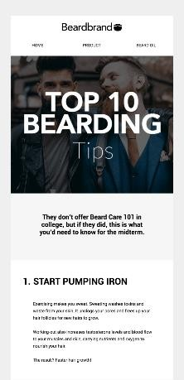
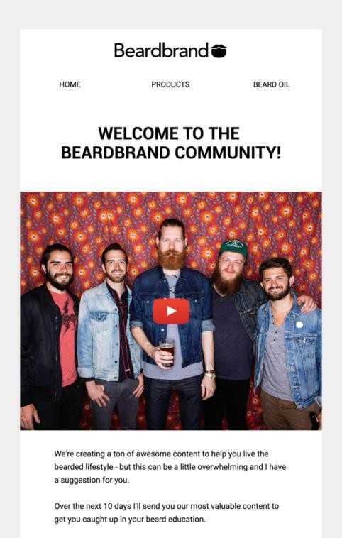
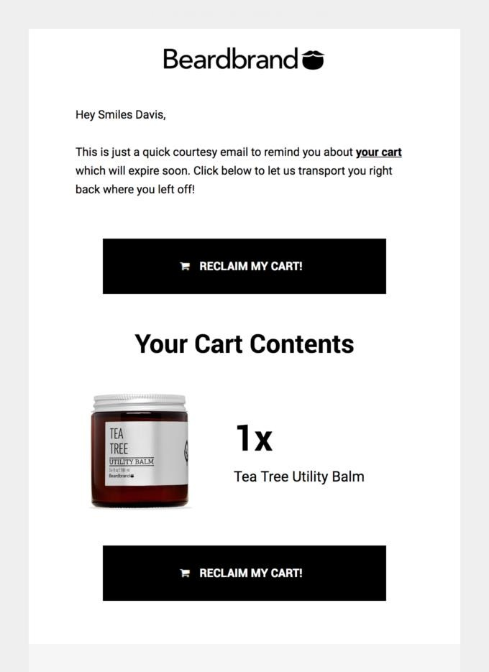
Email Types & Purposes
RELEVANCE & IMPACT
Newsletters
Newsletters meant to maintain the relationship & keep the brand top-of-mind.
Examples: Product Launches; Sales
Lifecycle Campaigns
Nurturing communications sent to customers based on their stage of the lifecycle.
Examples: Welcome; Reengagement
Transactional Emails
Automated campaigns sent based on customer behaviors & actions
Examples: Abandoned Cart; Receipt

Slide 7
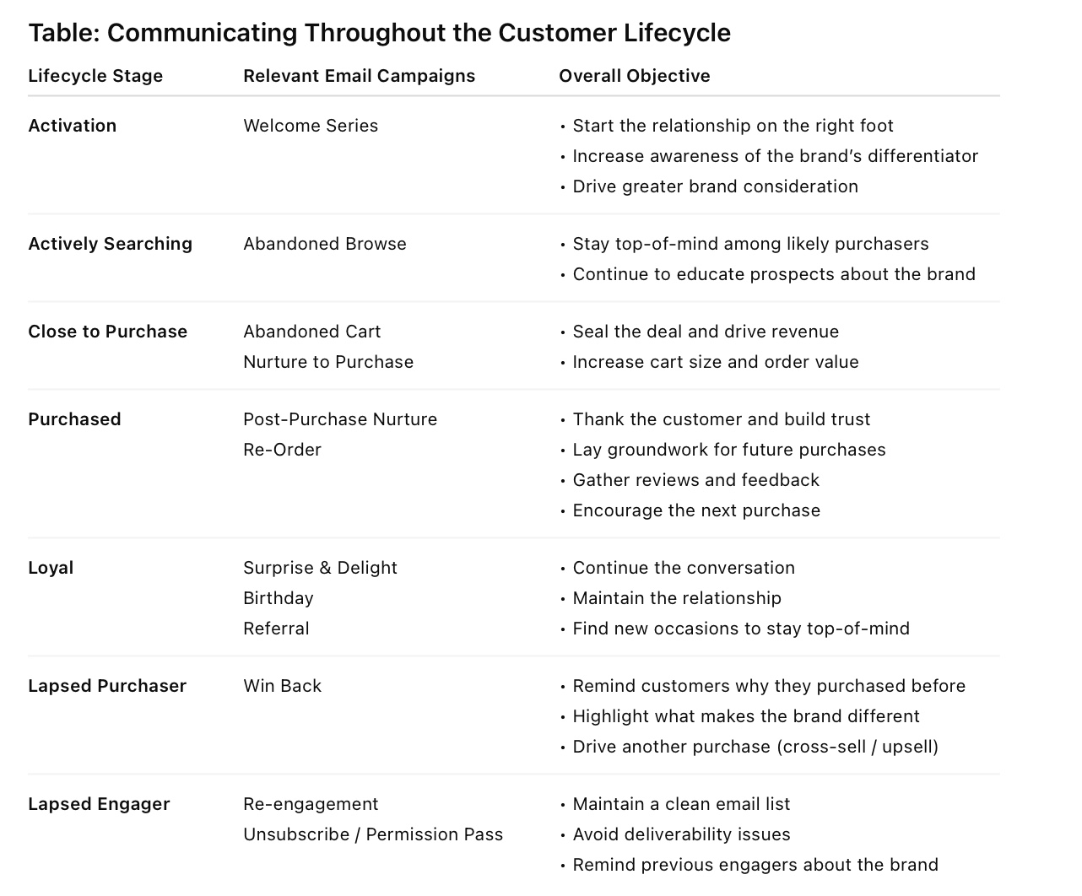

Slide 8
Email Best Practices

Slide 9

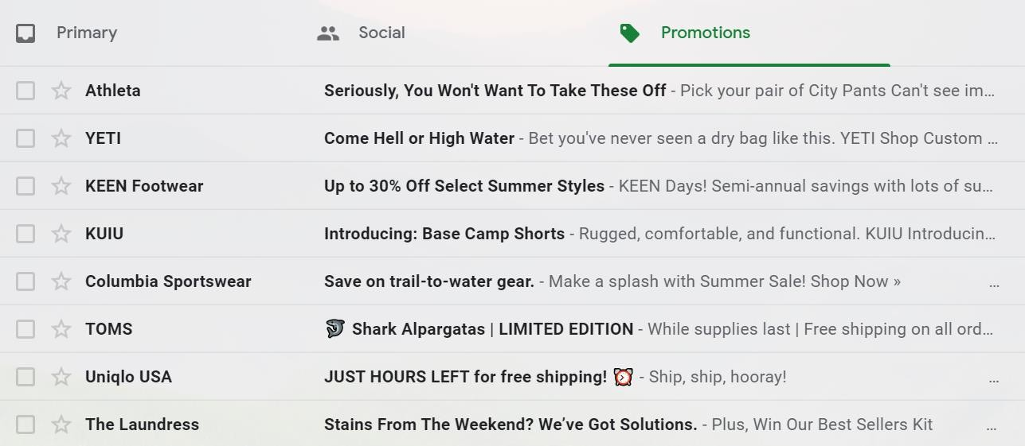
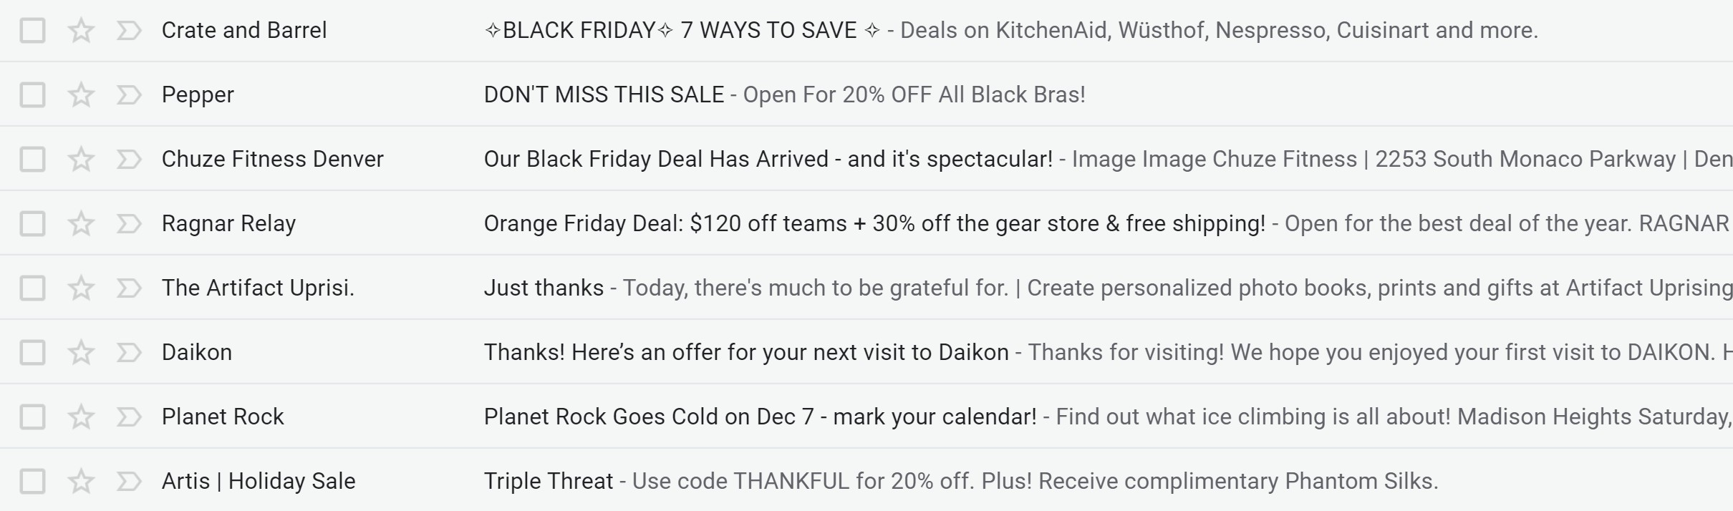

Getting the Open
FROM LINE
The name associated with the sender's email.
It is the first piece of
branding in an email.
SUBJECT LINE
The “teaser.” It is the copy that outlines the reason to open the email.
PREVIEW TEXT
The “hook.” It is typically displayed after the subject line in a
subscriber’s inbox.

Slide 10

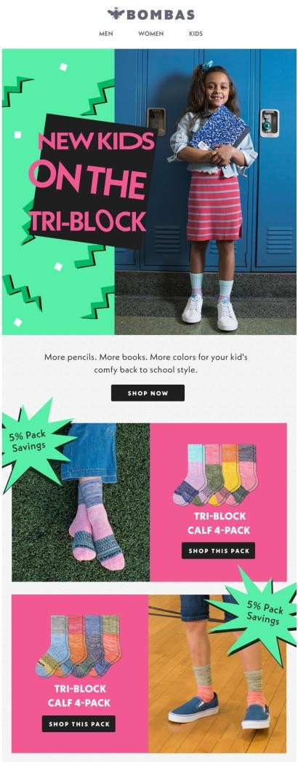

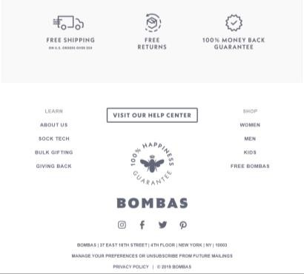
Email Anatomy
A
B
C
A
From Line
D
B
Subject Line
Get the Open
E
C
Preview text
F
D
Headline
Capture Attention
E
Preview Pane
F
Body
Engage &
drive action
G
G
Banner
H
Footer
Footer & Legal Requirements
H
9

Slide 11
Getting the Open
FROM LINE
SUBJECT LINE
PREVIEW TEXT
Recognizable
Descriptive
Supplemental to subject line
Try not to exceed 25 characters
Be consistent – continue to use the best one to aid deliverability
Need inspiration of where to start?
Check out your site navigation!
Develop subject lines along with content/creative production
Make it stand out by using special
characters, all caps or emojis
Use a compelling hook at the front
Language should be crisp, clear and intuitive
Test, Test, Test
No golden rule on length
Use PHT as the “hook” – Write the SL to engage and get the open and use the PHT to “hook” them with additional reasons to open.
Put the most important information at THE FRONT of your preview text
Be engaging & specific
Avoid covering everything in the
email
All 3 elements need to work together
to tell a story & drive the open

Slide 12
Template Design Best Practices
Brand Logo
Navigation
Navigation
Navigation
Inbox copy should tell an enticing story & introduce email content
The subject line & pre-header text should work together to tell this story.
Follow a hierarchy of information (inverted pyramid) & tell a story
The most important headline & CTA should be at the top of the campaign.
CTAs and text should get smaller as the subscriber scrolls
Include a call-to-action within the preview pane (first ~600 pixels)
You have limited time to grab a subscriber’s attention – make sure you give them a
way to engage without scrolling
Imagery should add to the story and complement the content
Calls-to-action should be descriptive & action-oriented
Ensure the template is mobile-friendly & responsive
Test your email across multiple devices & inboxes to ensure all content
renders correctly
Hero Module
Includes: Headline, CTA & short
introductory copy
This area should be image-heavy or
somehow grab the reader’s attention within
the preview pane
Secondary Content Includes: Headline, CTA & short copy
Tertiary Content
Includes: Short copy & CTA
Footer (include all legal requirements, social links & key business information)

Slide 13




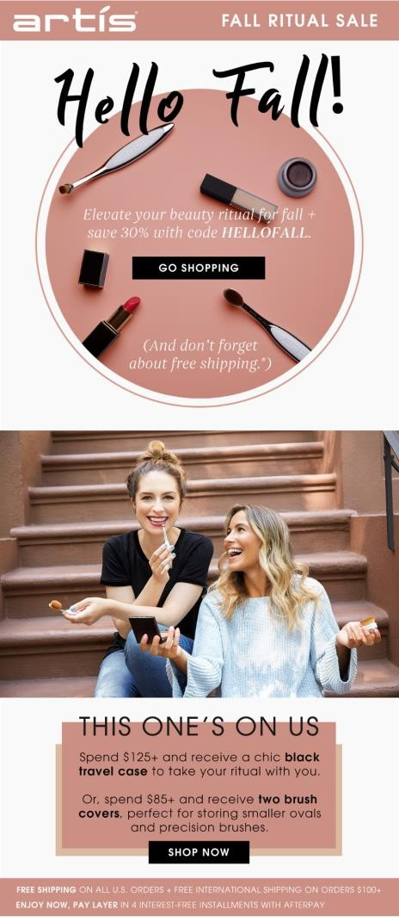
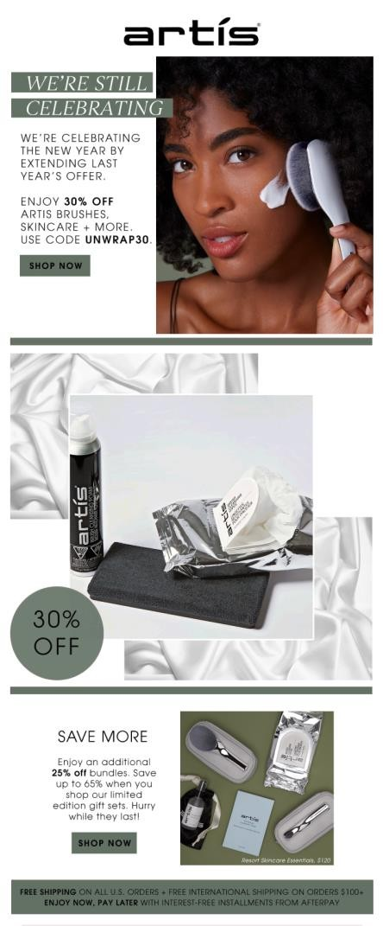
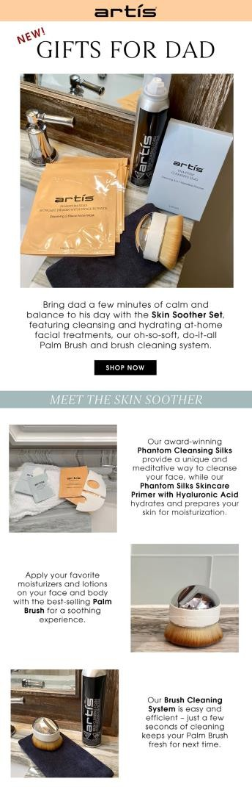
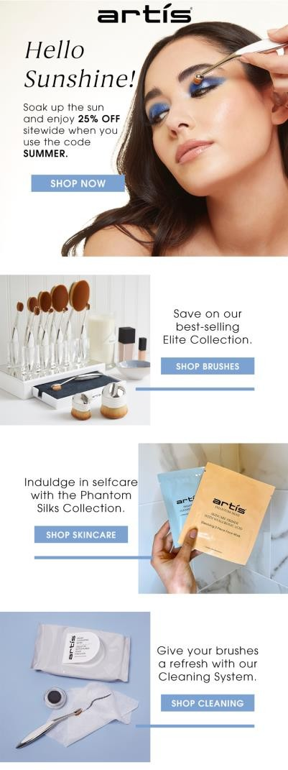
Content Strategy Best Practices
Build a quarterly or annual content calendar
This will help you prepare for upcoming holidays, seasons or other major promotions relevant to your business
By planning ahead of time, you can make sure that you have enough content to fill the months while still keeping your content fresh & engaging
Plan for 2-3 email newsletters per month

Slide 14




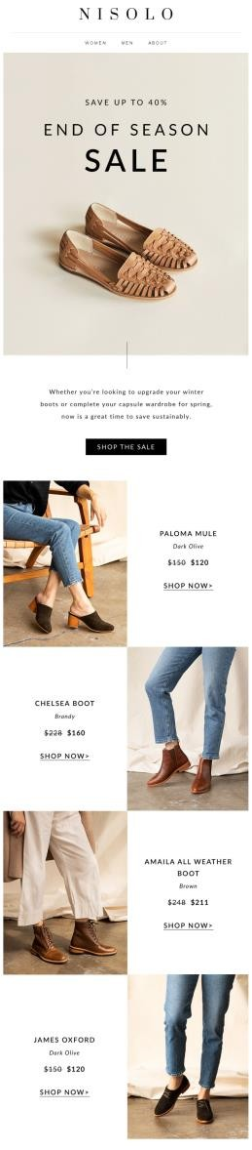
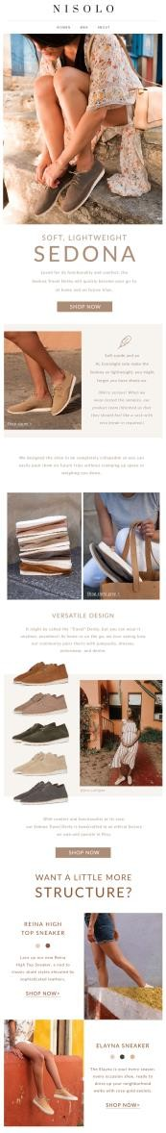

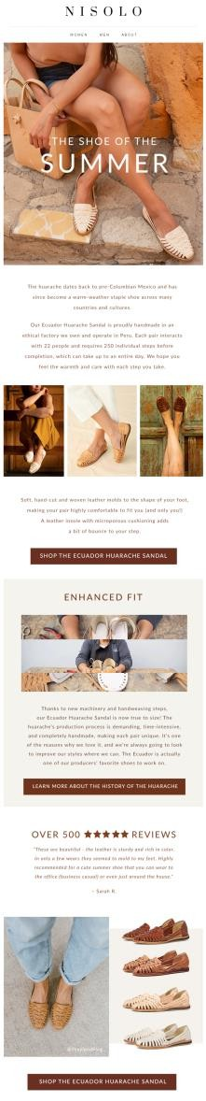
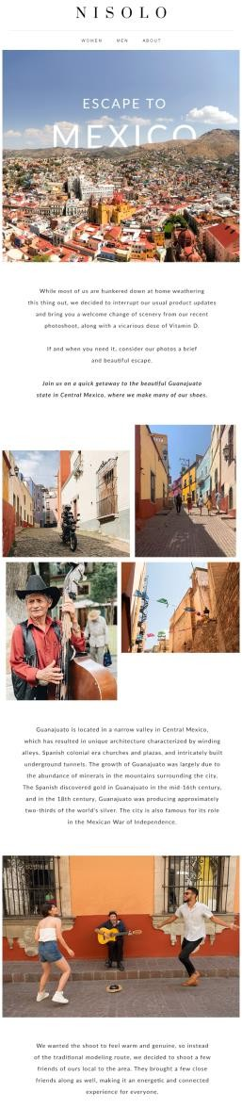
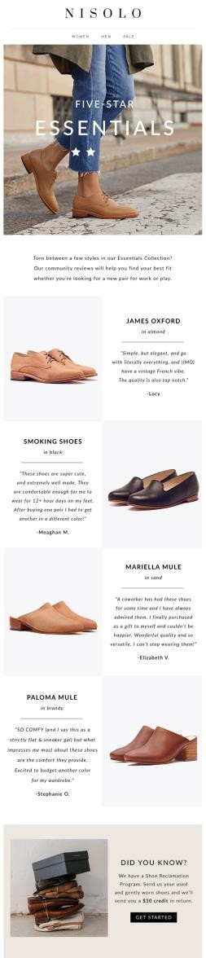
Content Strategy Best Practices
Use a variety of content
Email newsletters can be used to promote products & purchasing behavior or to encourage greater interaction with the brand. Balance promotion-heavy messages with additional content to keep customers interested.

Slide 15



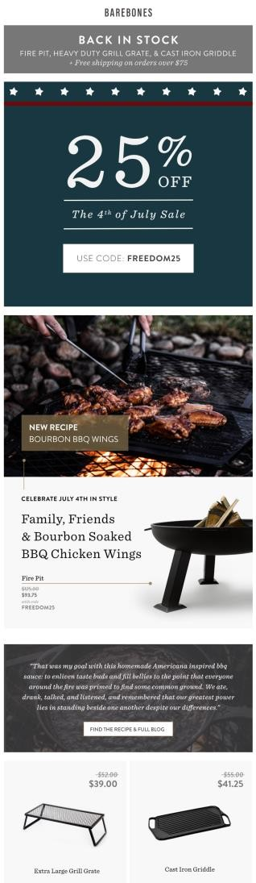

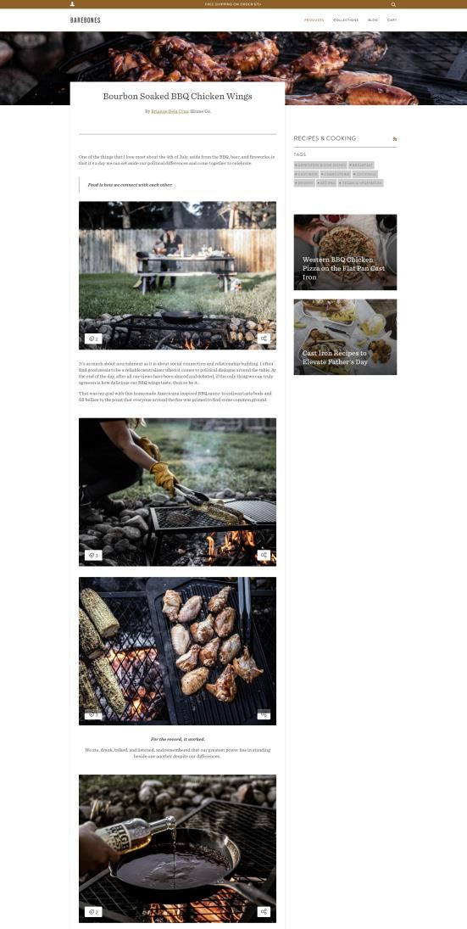

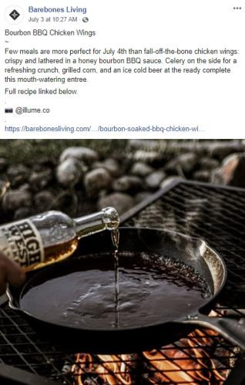



Content Strategy Best Practices
Integrate messaging across channels
Create a unified content & messaging strategy across all platforms. This does not mean the content has to be the exact same on every platform – different formats will work better on different platforms.
Integrating messaging will also help make content development more efficient. A single piece of content can be reformatted & repurposed for sharing across platforms.
For example, when a new blog is posted on the website, use an animated gif on Facebook that leads to the blog and include a short snippet of the blog & a compelling image within an email.
EMAIL
FACEBOOK
WEBSITE BLOG

Slide 16
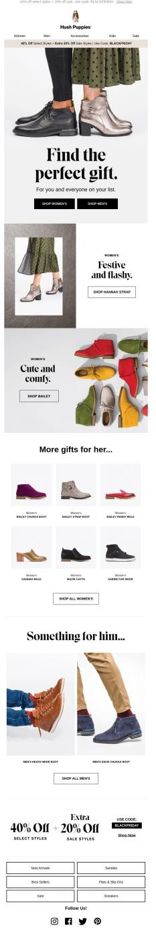

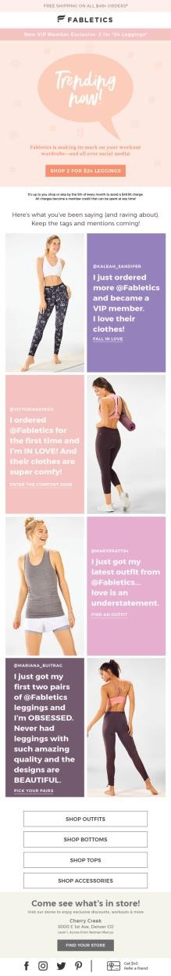

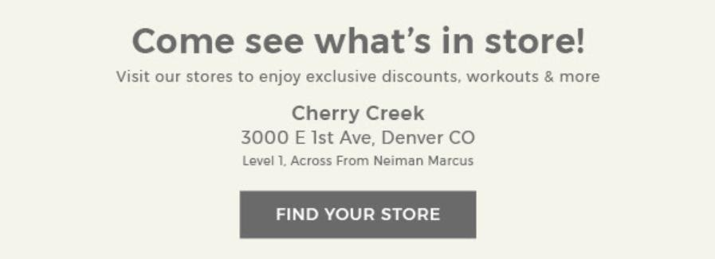
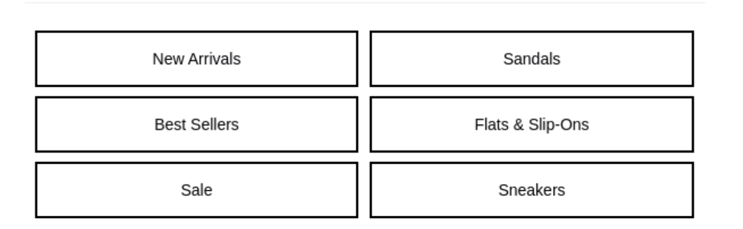
Content Strategy Best Practices
Develop “banners” for
reusable messages
It is common for brands to have “banners” for information that they consistently share with subscribers, such as payment options, delivery options or other reminders.

Slide 17


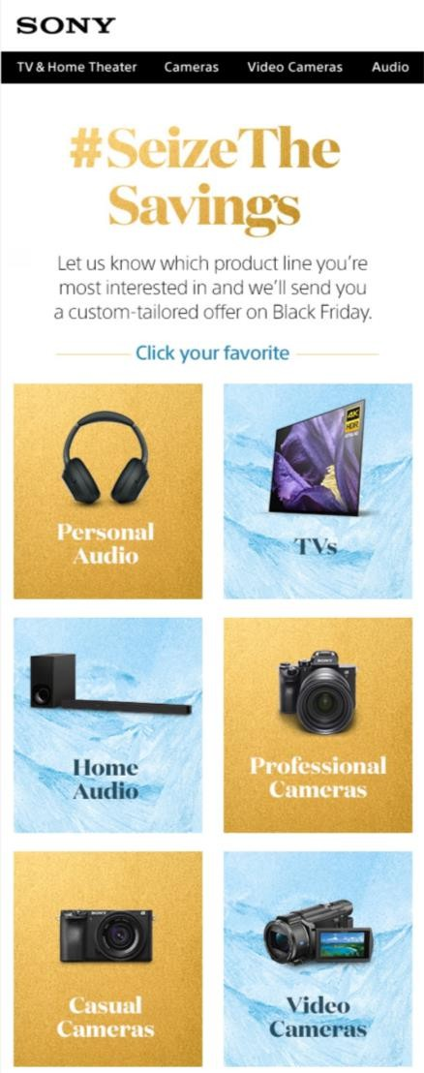
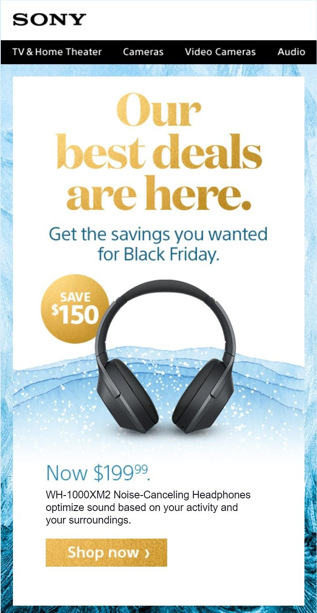
Content Strategy Best Practices
Customize email content based on audience segment & past behavior
Explore what options your email platform provides for segmentation, such as using past purchase behavior, past email engagement or geographic location.
17

Slide 18





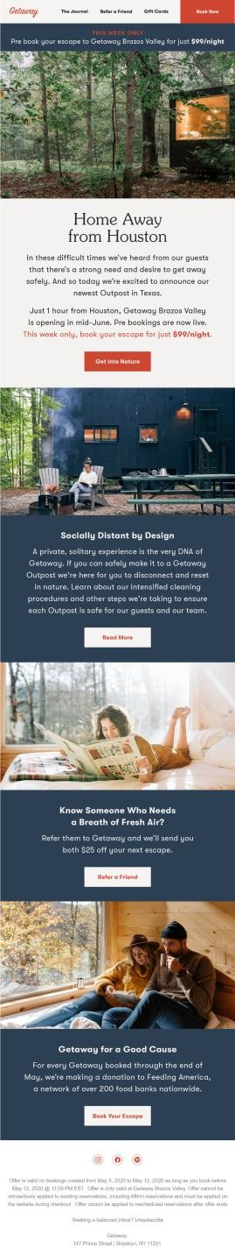
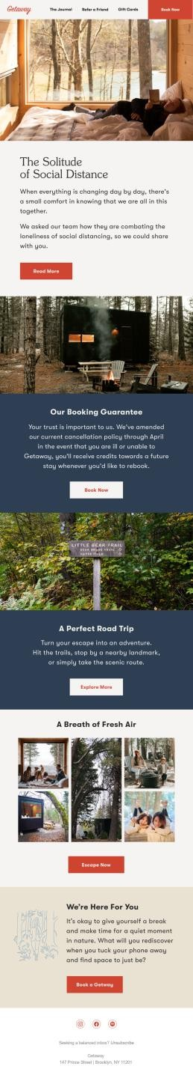
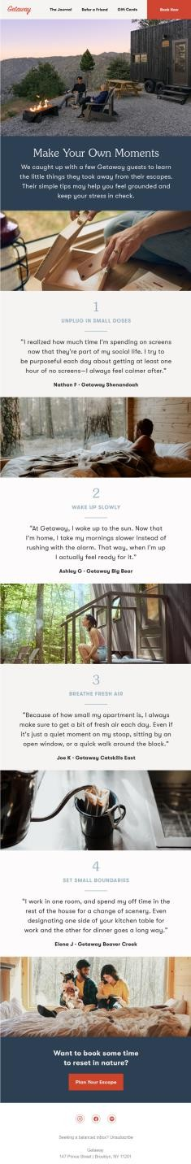
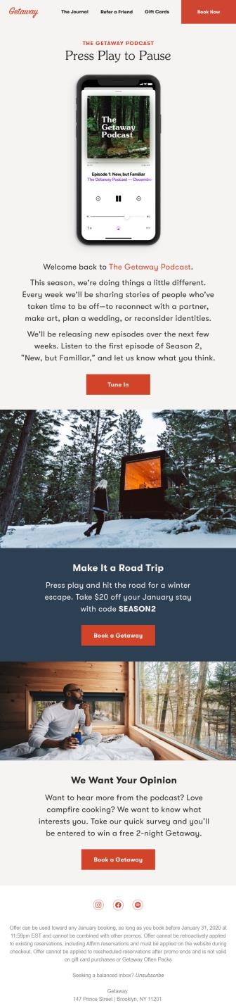
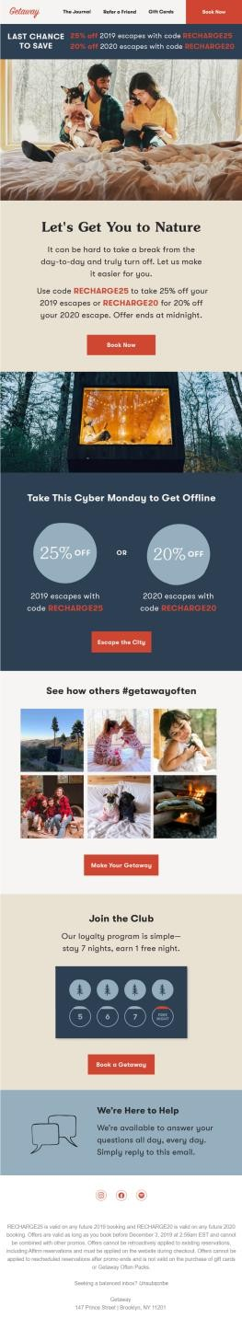
Best-in-Class Newsletters
Getaway
This travel brand does a good job of maintaining a consistent look to its newsletters while varying the content each time.
The template aligns to best practices:
The header includes valuable navigation links. The CTAs vary and use descriptive, action-oriented language. The modular design is mobile- and reader-friendly.
Subject Lines (left to right)
Announcing a Brand New Outpost
A moment of Zen
Simple Tips for Building Off-Time into Your Routine
The Getaway Podcast is back
Last Chance for 25% off an Escape

Slide 19




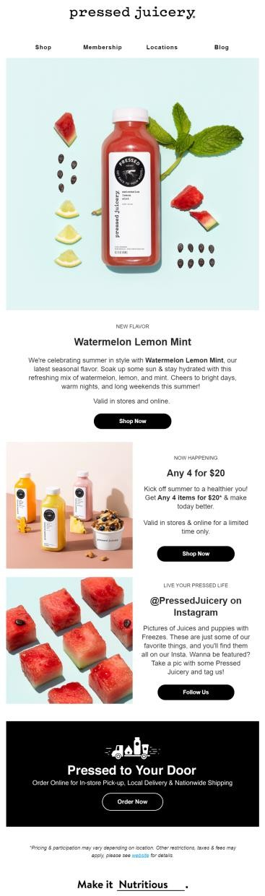
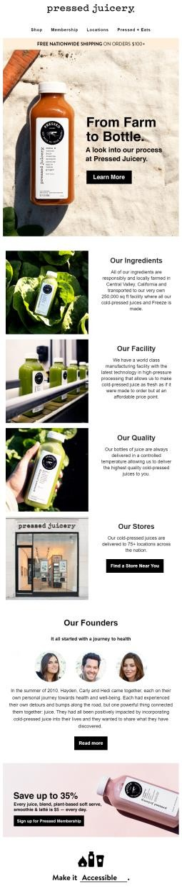
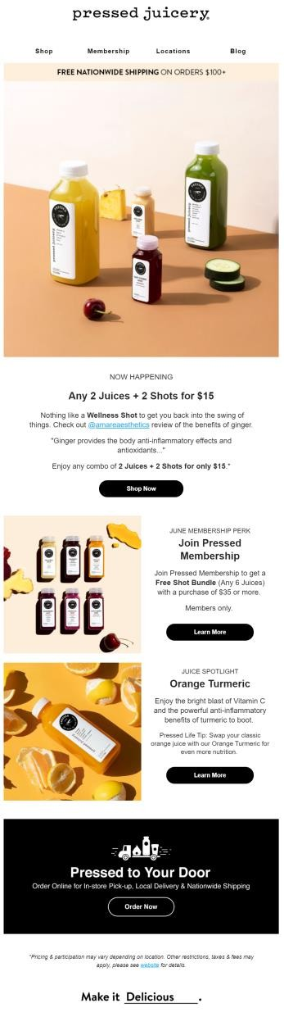
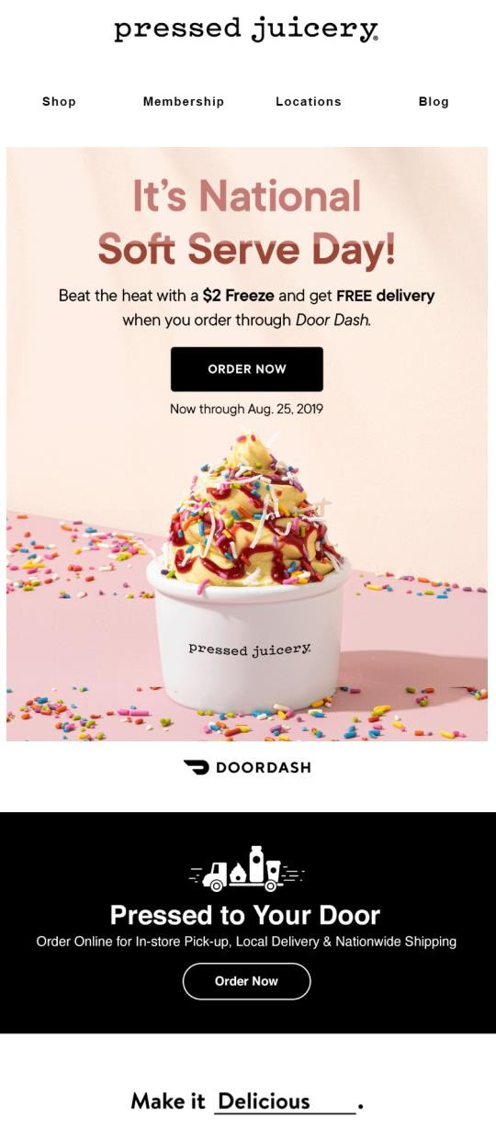
Best-in-Class Newsletters
Pressed Juicery
Across multiple campaign types – promotions, lifecycle messages and brand announcements – the template is consistent and clean.
A banner at the end of the email promotes delivery & pick up options. This reminder may help drive additional purchases.
The subject lines use a variety of techniques, helping to ensure subscribers continue to open.
Subject Lines (left to right)
New Flavor Alert 🍉
Pressed Juicery: From Farm to Fridge.
Start your weekend with Any 2 Juices + 2 Shots for $15
It's National Soft Serve Day! 🍦

Slide 20
Holiday Marketing Tips

Slide 21
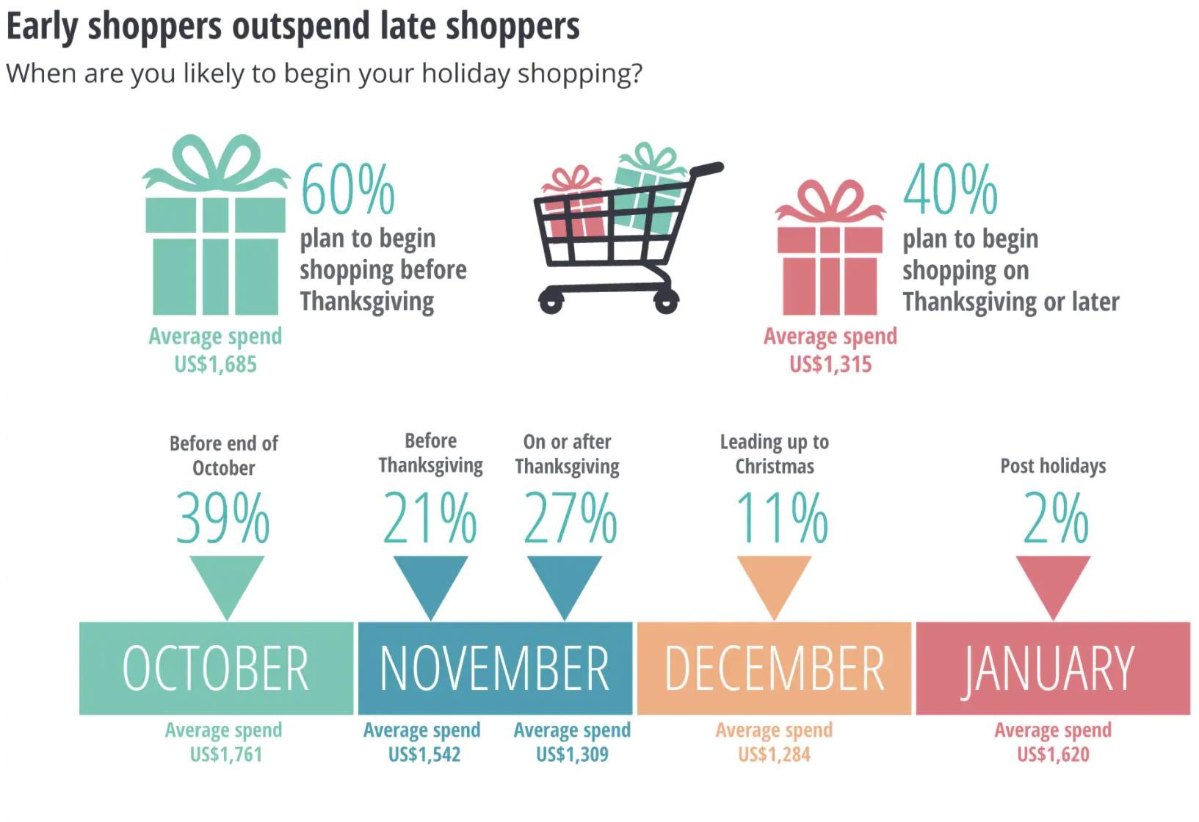
Most shoppers start before Thanksgiving
Start Early
60% of holiday shoppers start shopping before Thanksgiving
Early shoppers are likely to spend
$370 more than those who start
shopping
Continue Through December
More than half of shoppers will not complete their shopping process until December
Late November and mid-December is when almost half the holiday shopping occurs
Source: Deloitte Insights
21

Slide 22
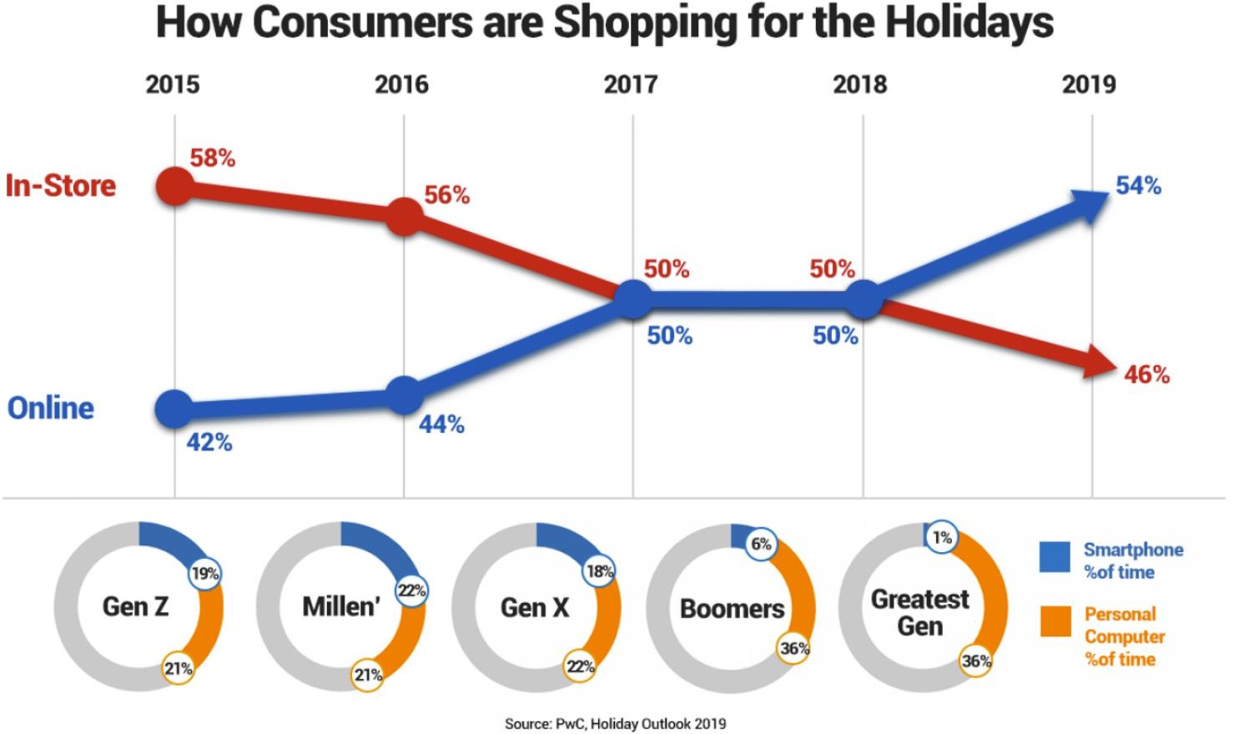
Online holiday sales will surge 25-35%
This year consumers will shop online
Deloitte expects online holiday sales to increase 25-35% for the 2020 season and reach $182-$196 billion
In 2019 eCommerce sales increased
13.6% YoY
Holiday sales will be flat
Total retail holiday sales will increase a modest 1-1.5% YoY
In 2019 total retail sales increased by 4.1% YoY
34% of merchants said they expect holiday sales to be lower than last year
Source: Deloitte Insights, Adobe Analytics
22

Slide 23
To succeed in the email marketing channel consider the following
Start promoting the holidays early
Increase newsletter cadence during November and December
Ensure you have key automations setup

Slide 24
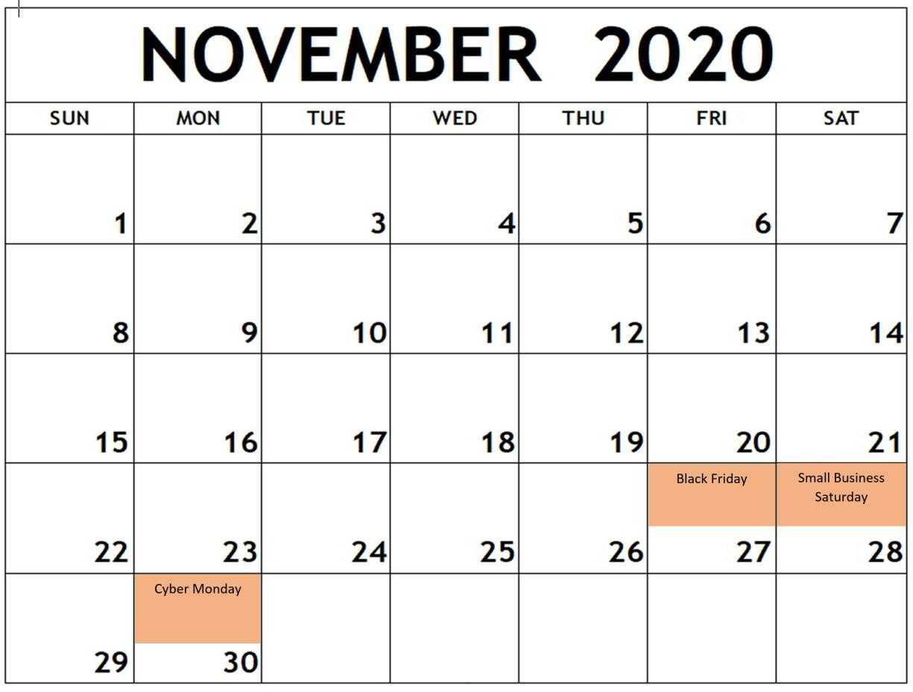
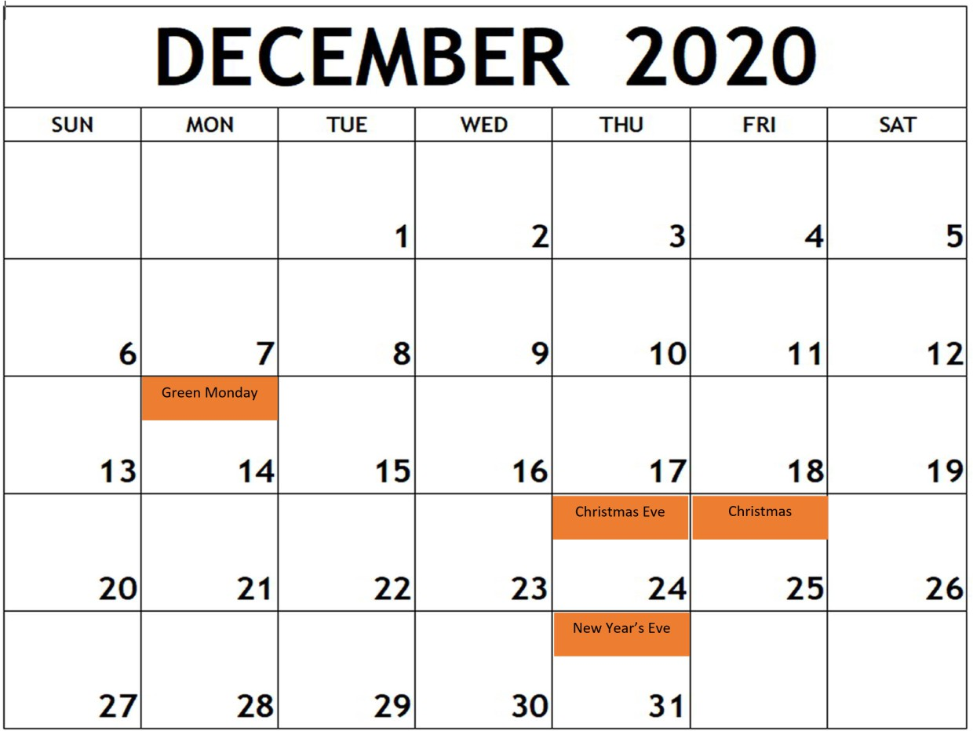
Start early and map out content for the entire holiday season

Slide 25
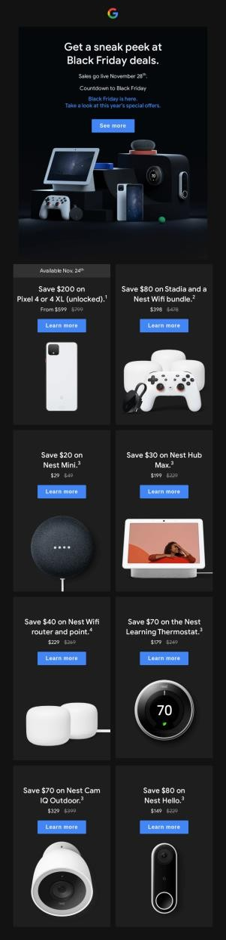
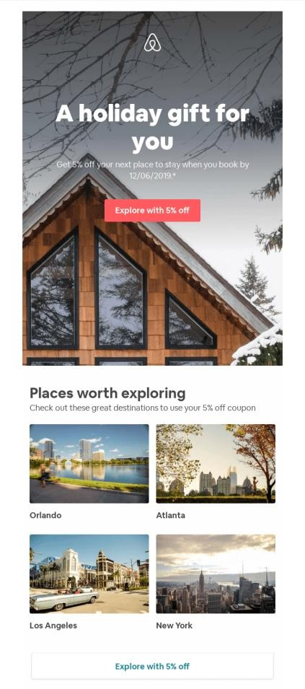
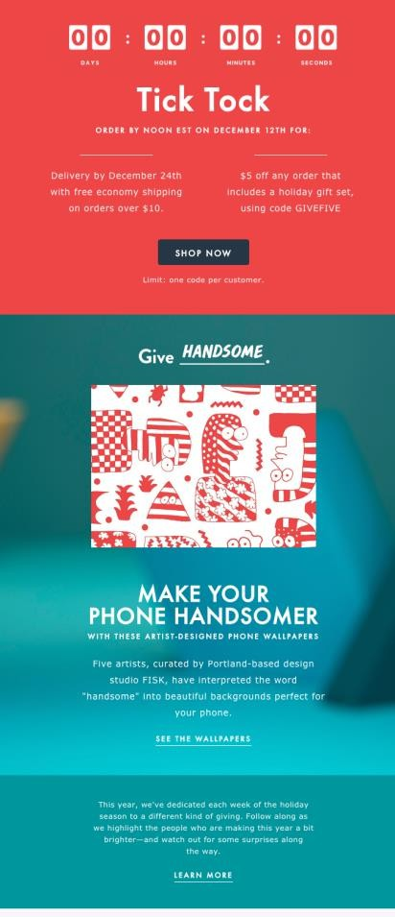
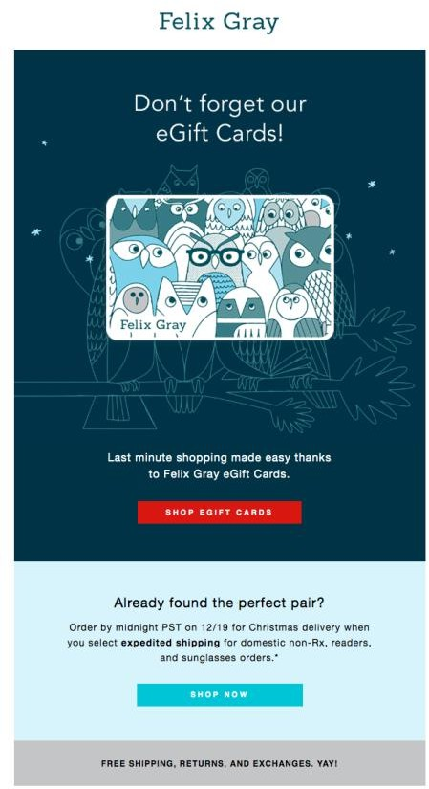
Email send volume increases dramatically during holidays
Email by the numbers in 2019
116.5 million emails were sent on Black Friday (more than any other day)
106 million emails were sent on Cyber Monday
Recommendation
To capitalize on holiday shopping intent increase email send frequency to keep your brand top of mind
Monitor KPIs like open rates and click rates to ensure you’re not over sending
25

Slide 26


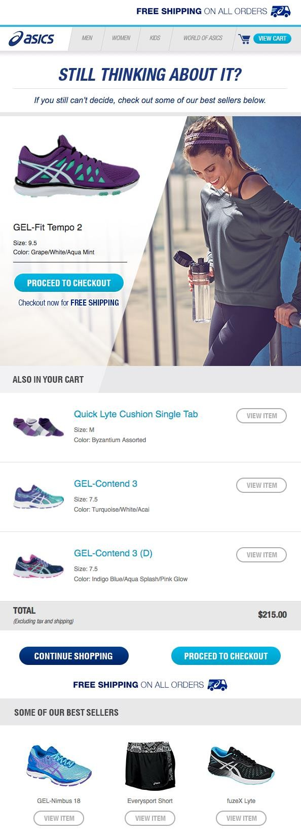
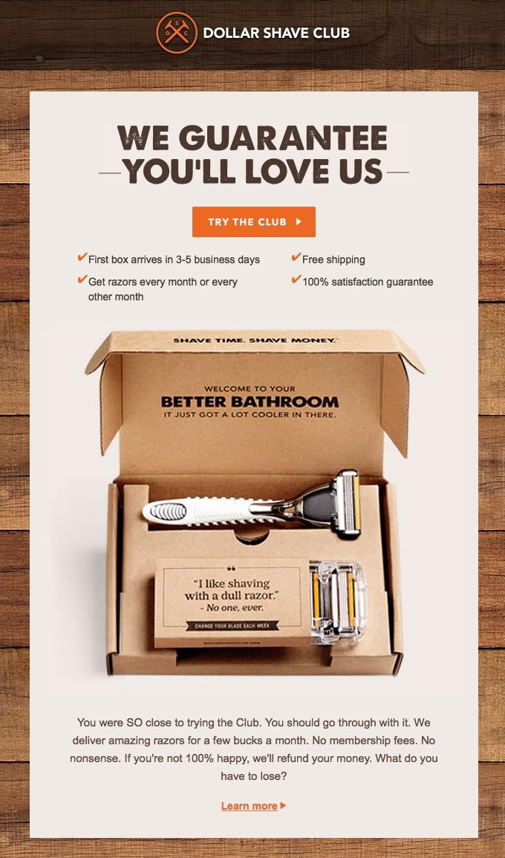
Ensure key email automations are setup and running during holidays
Email by the numbers in 2019
Email is responsible for 20% of online holiday site visits
Cart abandonment is higher than every during Black Friday and Cyber Monday, up to 74.5%
Recommendation
Ensure you have an abandon cart and abandon browse campaign in place
Consider adding a festive feel to abandon cart and abandon browse campaigns
26

Slide 27
Email Metrics

Slide 28
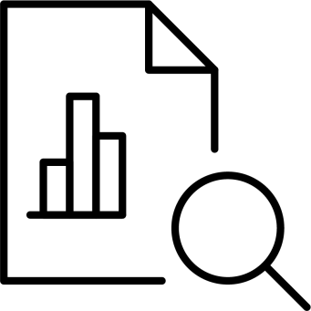
Email Metrics
Open Rate
Open Rate = Number of People who Opened the Email ÷ Number of People who Received the Email
This metric gives you an indication of how interested subscribers are in hearing from you.
Click Rate
Click Rate = Number of People who Clicked a Link in the Email ÷ Number of People who Received the Email
This metric provides an indication of how interesting the content was.
Deliverability & Spam Issues
Monitor the delivery rate (number of emails delivered ÷ number of sends attempted) to ensure your list is healthy & subscribers are receiving your messages
Also monitor unsubscribes, spam complaints & bounces to ensure you have a good reputation among inbox
providers (i.e. Gmail, Yahoo)
Revenue & Orders Placed
Your email platform may be able to track the number of purchases made from an email. Attribution methodologies differ across platforms and settings

Slide 29

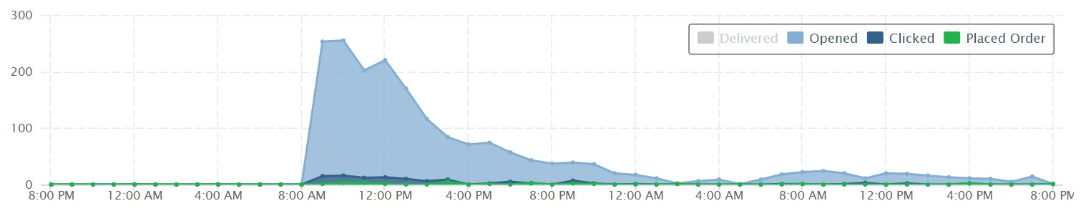


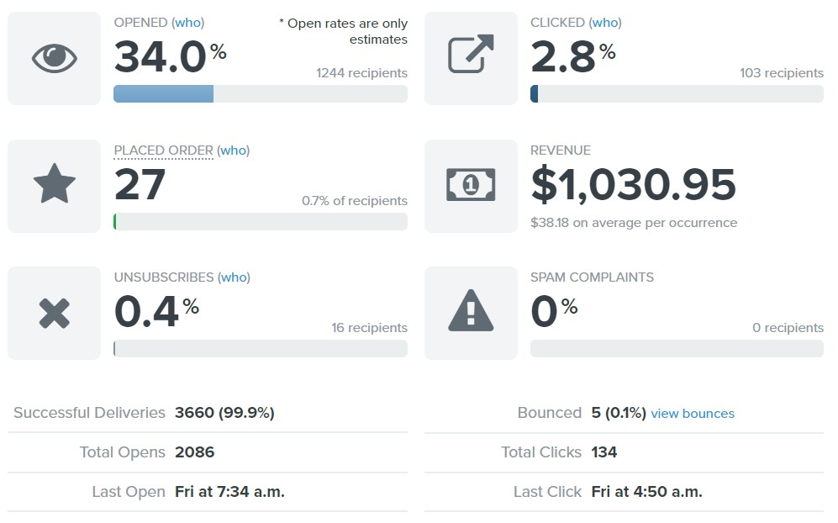
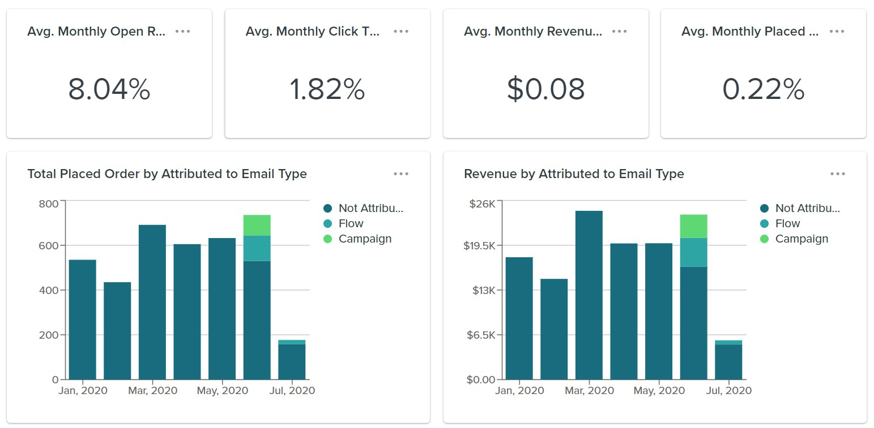
Sample Email Metrics Reports
29

Slide 30
List Health

Slide 31

List Health Tips
Don’t buy lists
Ensure you have permission to communicate with all of your subscribers
If you do acquire an email list legally, explain how you received the person’s email address (i.e. what partner
provided it) and require an active opt-in before emailing again
Email consistently
Try to send 2-3 emails per month to maintain a good sender reputation & ensure you land in the inbox
Clean your list periodically
Remove subscribers who have not engaged in over 1 year
Send win-back or permission-gathering campaigns to subscribers who have not engaged in 9-12 months
The more engaged your list is, the less likely you’ll end up in the spam folder
Follow all CAN-SPAM regulations (penalties can reach $43,280 per email!)
Don’t use false or misleading header information (i.e. from line, reply-to address)
Don’t use deceptive subject lines
Identify the message as an ad
Include your valid physical postal address
Tell recipients how to opt out of receiving future email from you & honor opt-out requests promptly.
Monitor what others are doing on your behalf
31

Slide 32
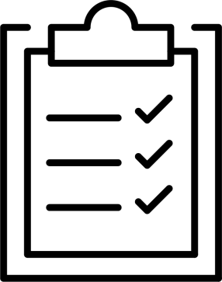
How to get people on your email list (when you’re a small business)
Website Options
Include a sign-up form in the footer
Use a pop-up with a sign-up offer
Require an email address for a purchase
Provide an option for purchasers to sign up for marketing communications as well as order notifications
Social Media
Create advertisements encouraging people to sign up for your newsletters
Encourage followers to sign up for newsletters through an organic post
Offline Methods
Collect email addresses at checkout
Promote email sign-ups while at events

Slide 33
Recommended Email Platforms

Slide 34




Email Platforms We Recommend
There are several email platforms designed for small businesses & non-technical users. We recommend these platforms because they are a good value and have lots of documentation available.
BUSINESS TYPE | BASIC FEATURES | SOPHISTICATED FEATURES
Business-to-Business (B2B)
Business-to-Consumer (B2C)
Non-Profits
34

Slide 35
LAB WORK: Create an Email Using Brevo
(Email Marketing Tool)

Slide 36
Step 1: Open the tool a.) Go to www.brevo.com b.) Click Sign up free Step 2: Create your account a.) Sign up using email / Google b.) Enter basic details (name, project/brand name) c.) Select Student / Personal project (if asked) Step 3: Verify your Email a.) Check your inbox b.) Click the verification link Log in to Brevo ⚠️ If Brevo shows paid plans → skip / close You are already on the Free plan, so go for it

Slide 37
Step 4: Go to the Dashboard a.) After login, you should see the Brevo Dashboard b.) Left menu will show: Home, CRM, Marketing, Campaigns Step 5: Create a Contact List a.) Go to CRM → Lists b.) Click Create a list c.) Name it as : Email Marketing Students List d.) Select “Your First Folder” e.) Click Create Step 6: Add sample contacts a.) Open your list b.) Click Add contacts c.) Add at least 5 email addresses (You may use your own email for testing)

Slide 38
Step 7: Create an Email Campaign a.) Go to Marketing → Campaigns b.) Click Create campaign c.) Select Email d.) Choose Regular campaign Step 8: Design the email (Drag & Drop) Use the Drag & Drop editor and add blocks in the order of your choice

Slide 39


Slide 40
You can explore these links too in case in you face a problem regarding sign up
1.) Brevo : www.brevo.com
2.) Mailchimp : https://login.mailchimp.com/signup/
3.) MailerLite – Free Forever Plan: https://accounts.mailerlite.com/signup
4.) SendPulse Free Signup: https://login.sendpulse.com/login/

Slide 41
End of Lecture

